Slide 1

21CSE354T – FULL STACK WEB DEVELOPMENT
UNIT 1
HTML, CSS OVERVIEW

Slide 2
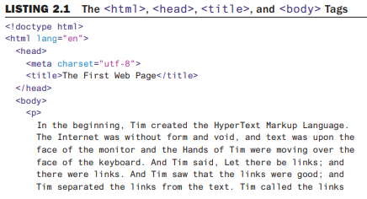
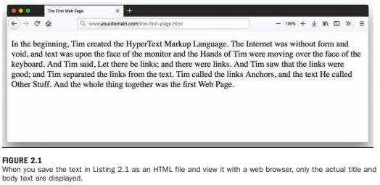

Structuring an HTML Document
Listing 2.1 shows an example of text you can type and save to create a simple HTML page with .html extension. If you open this file with Chrome, you would see the page shown in Figure 2.1.
Every web page you create must include a <!doctype> declaration, as well as <html></html>, <head></head>, <title></title> and <body></body> tag pairs.

Slide 3
Structuring an HTML Document (cont..)
The first line in the document is the document type declaration; you are declaring that it is html (specifically, HTML5) because html is the value used to declare a document as HTML5 in the tag. We have written this tag in all lowercase, but many people write it to differentiate it from the actual HTML in the document.
Types of tags:
  An opening tag is an HTML tag that indicates the start of an HTML command; the text affected by the command appears after the opening tag. Opening tags always begin with < and end with >, as in <html>.
  A closing tag is an HTML tag that indicates the end of an HTML command; the text affected by the command appears before the closing tag. Closing tags always begin with </, as in </html>.
  An empty tag is an HTML tag that issues an HTML command without enclosing any text in the page. Empty tags always begin with < and end with > and have no closing tag, as in <meta>. Some designers add a closing /> to empty tags, as in <meta/>, but this is not required in HTML5.
The <body> tag in Listing 2.1 tells the web browser where the actual body content of the page begins, and </body> indicates where it ends. Everything between the <body> and </body> > tags appears in the main display area of the web browser window.
The very top of the browser window shows title text, which is any text that is located between <title> and </title>. It’s important to provide titles for your pages so that visitors to the page can properly bookmark them for future reference.

Slide 4
Structuring an HTML Document (cont..)
You define the character set used by the page with the tag <meta charset=“utf-8”>. This tag defines the character set the page will be written in—in this case UTF-8.
This tag should always come right after the opening <head> tag in your HTML documents. Without it, your pages could become vulnerable to hackers.
You will use the <body> and <title> tag pairs in every HTML page you create because every web page needs a title and body text.
Putting at the very beginning of a document simply indicates that the document is a web page. The </html> at the end indicates the end of the web page.
The <p> tag in Listing 2.1 encloses a paragraph of text. You should enclose your chunks of text in the appropriate container elements whenever possible.

Slide 5
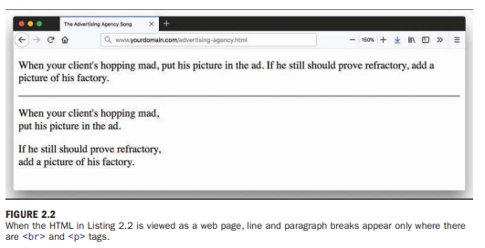
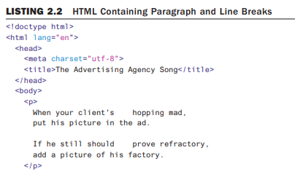
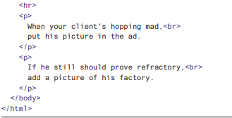
Structuring an HTML Document (cont..)
Paragraphs and Line breaks
When a web browser displays HTML pages, it pays no attention to line endings or the number of spaces between words.
For example, the top version of the poem in Figure 2.2 appears with a single space after each word, even though that’s not how it’s entered in Listing 2.2. This is because extra whitespace in HTML code is automatically reduced to a single space.

Slide 6
Structuring an HTML Document (cont..)
Paragraphs and Line breaks (cont..)
You must use HTML tags if you want to control where line and paragraph breaks actually appear. When text is enclosed within the <p> </p> container tags, a line break is assumed after the closing tag.
The <br> tag forces a line break within a paragraph. Unlike the other tags you’ve seen so far, <br> tag doesn’t require a closing tag.
The poem in Listing 2.2 and Figure 2.2 shows the <br> and <p> tags used to separate the lines and verses of an advertising agency song.
You might have also noticed the <hr> tag in the listing, which causes a horizontal line to appear on the page (Figure 2.2).
Inserting a horizontal rule with the <hr> tag also causes a line break, even if you don’t include a <br> tag along with it.
Like <br>, the <hr> horizontal rule tag is an empty tag and, therefore, never gets a closing </hr> tag.

Slide 7
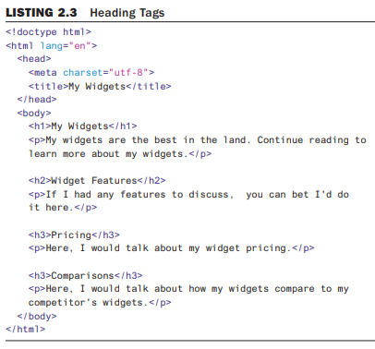
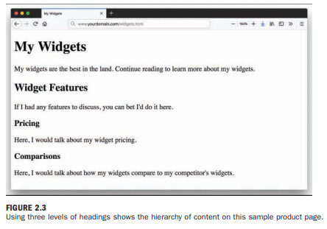
Structuring an HTML Document (cont..)
Headings
Listing 2.3 is sample code and text for a simple web page containing an example of a heading as compared to normal paragraph text. Any text between the <h1> and </h1> tags will appear as a large heading. In addition, <h2> and <h3> and so on, as far down as <h6>, make progressively smaller headings.

Slide 8
Structuring an HTML Document (cont..)
Semantic elements
HTML5 includes tags that enable you to describe the semantics—the meaning—of the information that you provide in your marked-up text. Instead of simply using HTML as a presentation language, as was the practice in the very early days when <b> for bold and <i> for italic was the norm, modern HTML has as one of its goals the separation of presentation, meaning, and behavior.
Some of the semantic elements available in HTML5 follow:
  <header></header> - This might seem counterintuitive, but you can use multiple <header> tags within a single page. The tag should be used as a container for introductory information, so it might appear only once in your page (likely at the top)—but you also might use it several times if your page content is broken into sections.
  — <footer></footer> - used to contain additional information about its containing element (page or section), such as copyright and author information or links to related resources. Just as with the <header> tag, you can define footers in any section of the page, as well as for the page as a whole.
  — <nav></nav> - If your site has navigational elements, such as links to other sections within a site or even within the page itself, these links go in a <nav> tag.
  <section></section> - contains anything that relates thematically; it can also contain a <header> tag for introductory information and possibly a <footer> tag for other related information. You can think of a <section> as carrying more meaning than a standard <p> or <div> tag, which typically conveys no meaning at all.

Slide 9
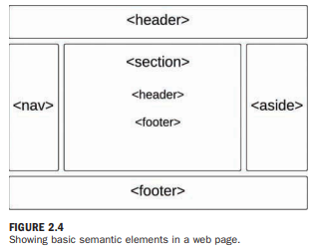
Structuring an HTML Document (cont..)
Semantic elements (cont..)
  <article></article> - like a <section> tag, in that it can contain a <header>, a <footer>, and other container elements such as paragraphs and divisions. But the additional meaning carried with the tag is that it is, well, like an article in a newspaper or some other publication. Use this tag around blog posts, news articles, reviews, and other items that fit this description. One key difference between an <article> and a <section> is that an <article> is a standalone body of work, whereas a <section> is a thematic grouping of information.
  <aside></aside> - Use the <aside> tag to indicate secondary information; if the <aside> tag is within a <section> or an <article>, the relationship will be to those containers; otherwise, the secondary relationship will be to the overall page or site itself. It might make sense to think of the <aside> as a sidebar—either for all the content on the page or for an article or other thematic container of information.

Slide 10
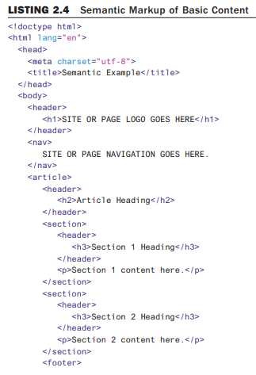
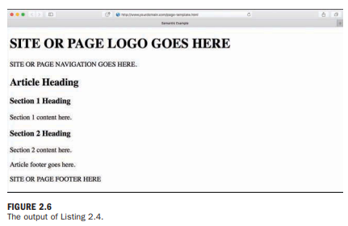
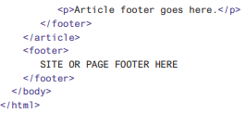
Structuring an HTML Document (cont..)
Semantic elements (cont..)

Slide 11
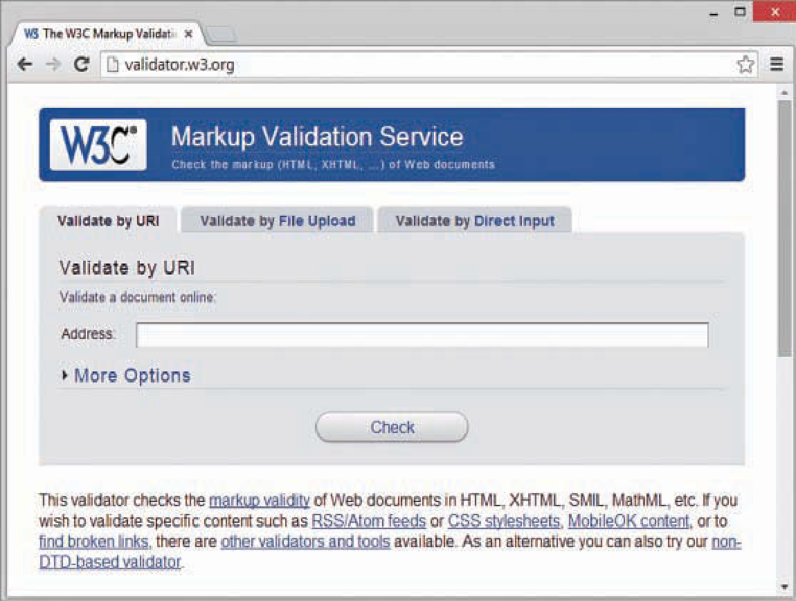
Validating and debugging your code
Validation is the process of testing your pages with a special application that searches for errors and makes sure the pages adhere to the current HTML and CSS standards.
The standards body responsible for developing web standards, the World Wide Web Consortium (W3C), offers an online validation tool you can use, at https://validator.w3.org.
Figure 5.1 shows the options for using the W3C Markup Validation Service.
FIGURE 5.1
The W3C Markup Validation Service enables you to validate an HTML document to ensure that it has been coded accurately.

Slide 12
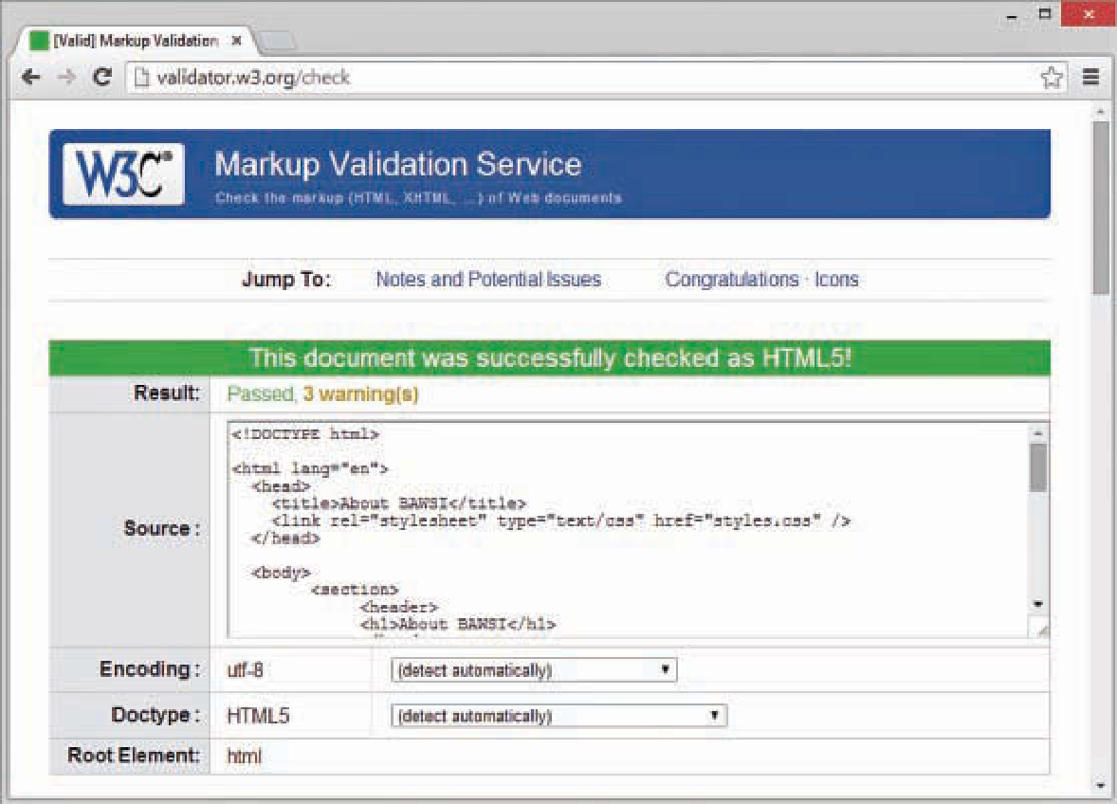
Validating and debugging your code (cont..)
If you’ve already published a page online, you can use the Validate by URI tab. Use the Validate by File Upload tab to validate files stored on your local computer file system.
The Validate by Direct Input tab enables you to paste the contents of a file from your text editor. If all goes well, your page will get a passing report, like the one shown in Figure 5.2, which validates a code.
FIGURE 5.2
If a page passes the W3C Markup Validation Service, you know that the code is ready for prime time.

Slide 13
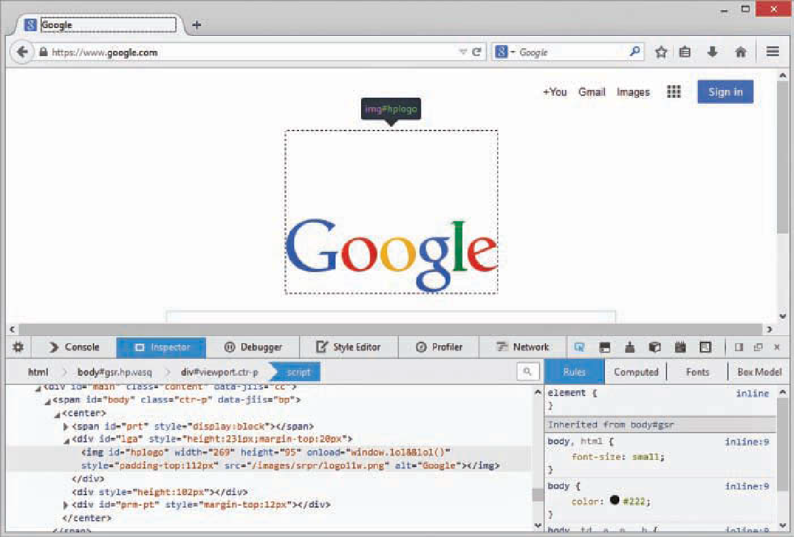
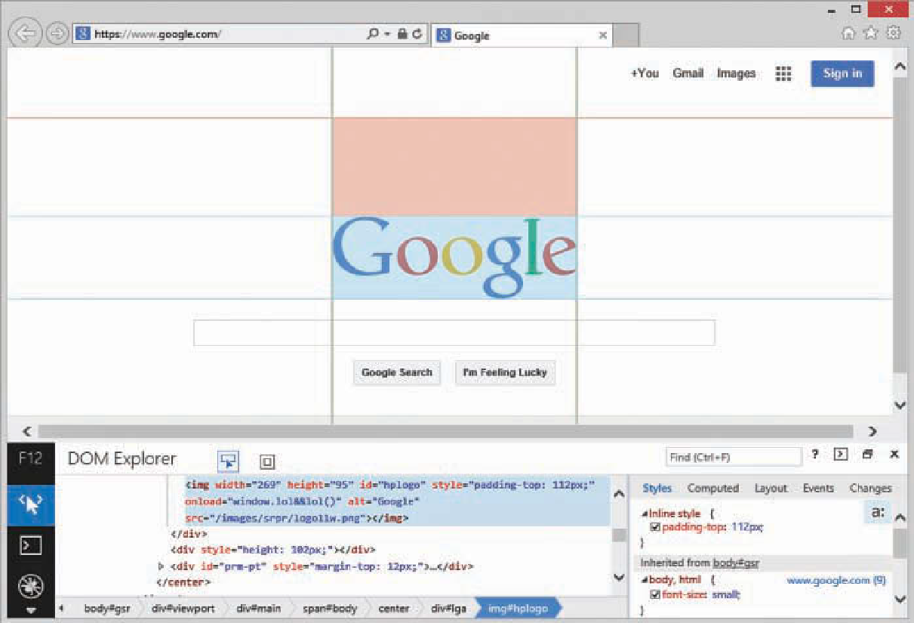
Validating and debugging your code (cont..)
You can extend your debugging efforts beyond basic validation by using more advanced tools that are built into most major browsers. Figures 5.4 and 5.5 show what some of the major browsers look like with Developer Tools turned on; in each figure you’ll notice some consistencies in the names and functionalities of certain tools.
FIGURE 5.4
Inspecting an element containing the Google logo using Developer Tools in Firefox.
FIGURE 5.5
Inspecting an element containing the Google logo using Developer Tools in Microsoft Internet Explorer.

Slide 14
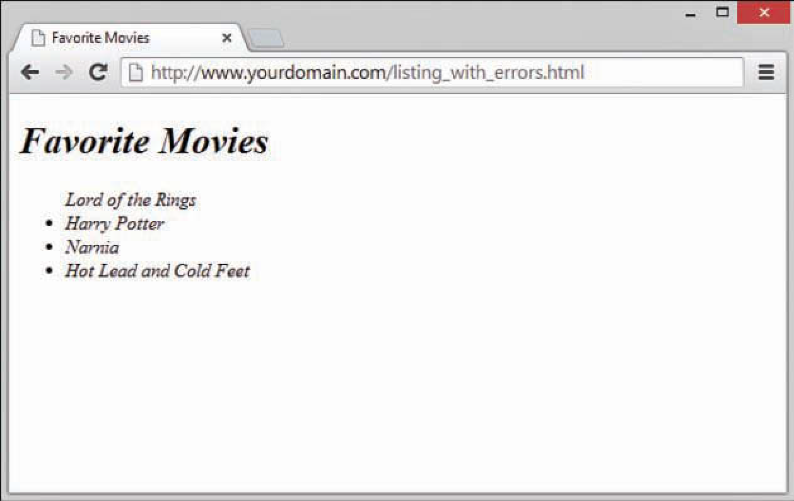
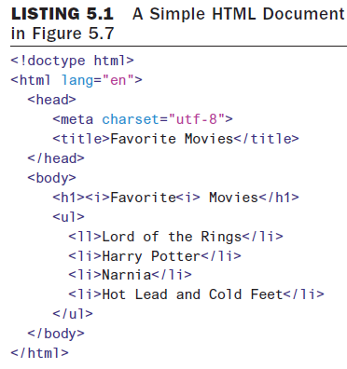
Validating and debugging your code (cont..)
Debugging HTML using Inspector:
To illustrate how to use the inspector to debug HTML, consider the code in Listing 5.1, which is just a basic HTML document containing a list of movies, where the word “Favorite” in the heading is supposed to be italic. However, if you look at the rendered version in Figure 5.7, you’ll see some problems: Everything is italic, and there is no bullet in front of the first list item. These problems are caused by just two characters in all the text.
FIGURE 5.7
This web page has two problems: only the word “Favorite” should be italic, and there is no bullet in front of the first list item.

Slide 15
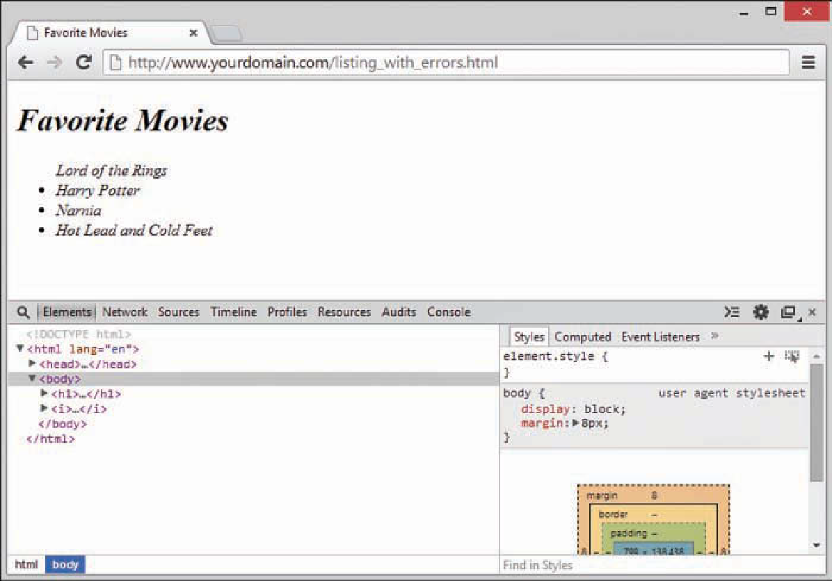
Validating and debugging your code (cont..)
Debugging HTML using Inspector (cont..):
Follow along with these steps to find and fix the HTML syntax problems using the inspector in Developer Tools:
  Add the code in Listing 5.1 to a new file, save the document, and then open it in your modern browser (Chrome, Firefox, Safari, or Edge).
  Right-click the screen and choose Inspect Element. You should see something like what’s shown in Figure 5.8, with the Elements tab preselected.
In your source file, change the second <i> tag to a closing </i> tag and save the document.
Refresh the document in the browser. Notice that, as shown in Figure 5.10 (PTO), the word “Favorite” is now italic, as it should be, and all the phantom <i> elements are gone from the inspector;
however, the bullet point is still missing from the first list item in the browser’s display.
FIGURE 5.8
The Elements tab is selected by default

Slide 16
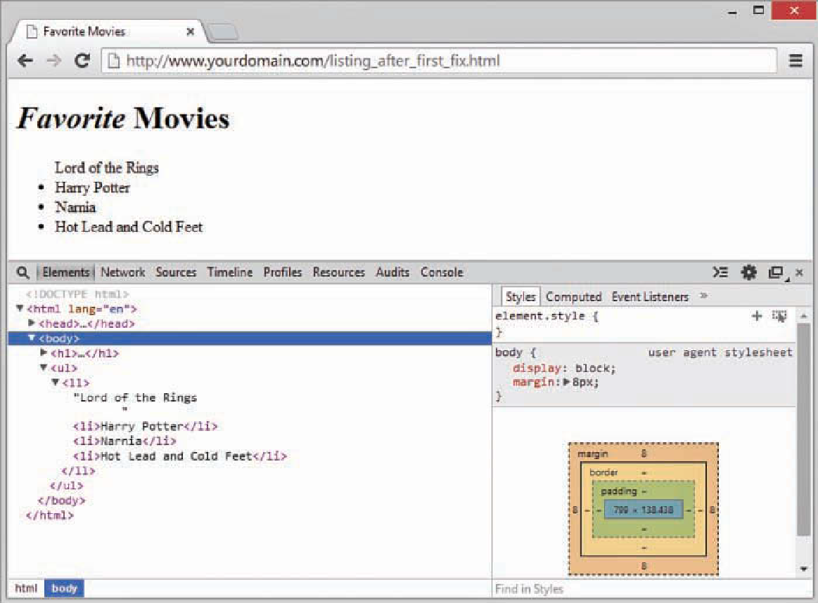
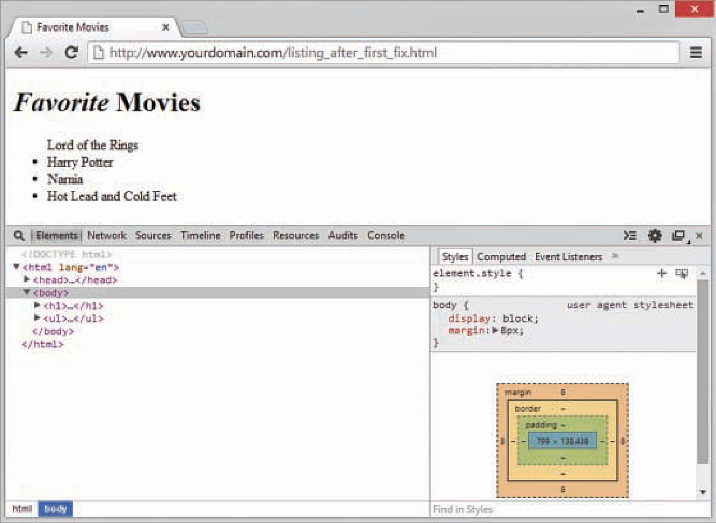
Validating and debugging your code (cont..)
Debugging HTML using Inspector (cont..):
Go back to the Elements panel and expand the <ul> element and then the <ll>, as shown in Figure 5.11. Notice that instead of a set of four appropriately opened and closed <li> elements under the <ul> element, there is an open <ll> tag followed by three <li> elements within it, and then a closing </li> tag.
In the source code the <ll> element is closed by an </li> tag, the opening tag should be an <li> tag.
FIGURE 5.10
This web page now has only one problem: no bullet point on the first list item.
FIGURE 5.11
Viewing the DOM reveals that the browser sees an <ll> tag under the <ul> tag, not a set of <li> tags.

Slide 17
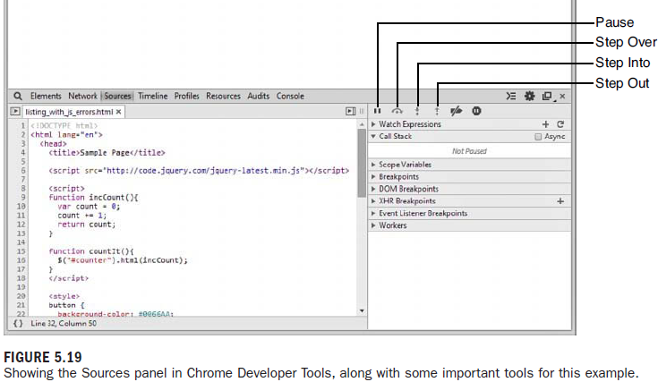
Validating and debugging your code (cont..)
Taking a Closer Look at the Sources Panel:
The Sources panel (Debug panel in Firefox and Debugger in Safari) contains a set of tools that enable you to pause, resume, and step through code that is loaded in the web browser.
By setting breakpoints, you can watch individual sections of your code execute, which is especially helpful when you are trying to track down issues that are unrelated to basic syntax.
To debug the script, we’ll focus on setting breakpoints and stepping through the code using the tools highlighted in Figure 5.19.

Slide 18
Validating and debugging your code (cont..)
Taking a Closer Look at the Sources Panel (cont..):
Breakpoints—Breakpoints enable you to specify where you would like to stop the JavaScript from executing. When you set a breakpoint, the browser stops executing and breaks into the debugger before it executes that line of code. You set a breakpoint by clicking on a line number in the code listing, and you remove a breakpoint by clicking the line number again. The Breakpoints tab shows a list of breakpoints that have been set.
Step Over—When you click the Step Over icon, the code advances one line. If the line of code is to execute another function, that function is executed, and you are taken to the next line of code in the current function. If a breakpoint is encountered when stepping over a function, the browser stops executing at that location in the script.
Step Into—When you click the Step Into icon, the code advances one line. If the line of code is to execute another function, you are taken to the first line of code in that function.
Step Out—When you click the Step Out icon, the current function finishes executing, and you are taken to the next line of code in the calling function.

Slide 19
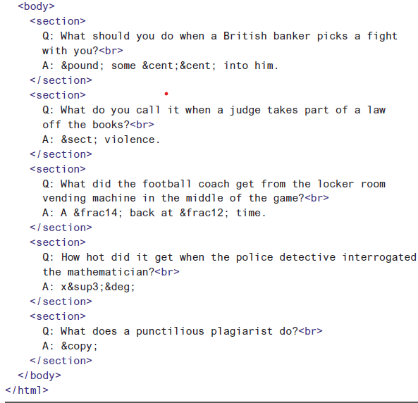
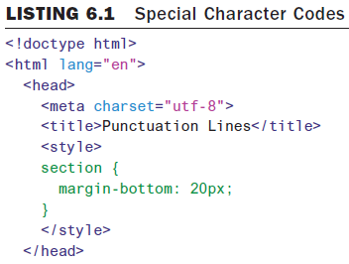
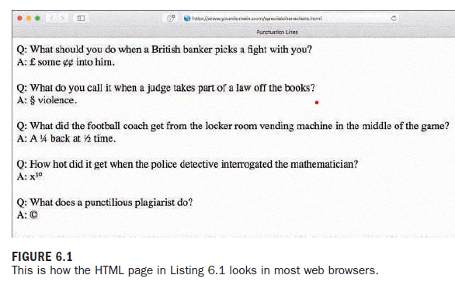
Working with Fonts, Text Blocks, Lists and Tables
Working with special characters:
Listing 6.1 and Figure 6.1 show several of the symbols from Table 6.1 in use.
For example, you can produce the word café by using either of the following:
  caf&eacute; and caf&#233;

Slide 20
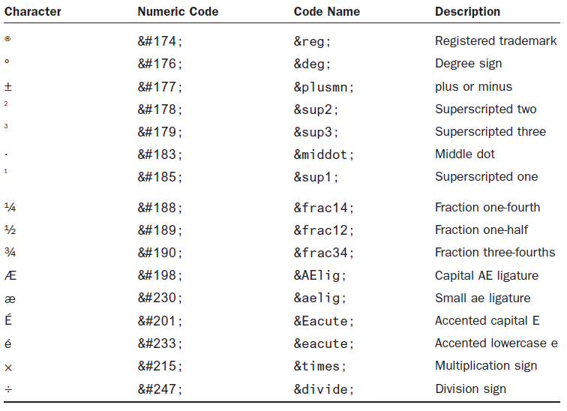
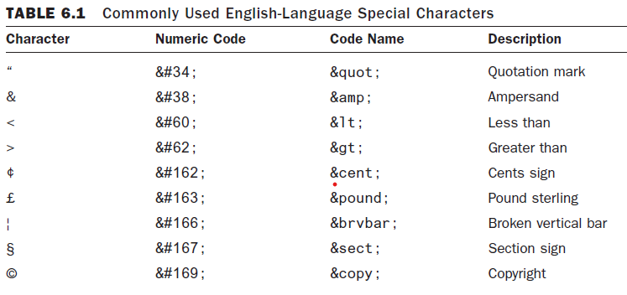
Working with Fonts, Text Blocks, Lists and Tables
Working with special characters (cont..):
Listing 6.1 and Figure 6.1 show several of the symbols from Table 6.1 in use.
For example, you can produce the word café by using either of the following:
  caf&eacute;
  caf&#233;

Slide 21
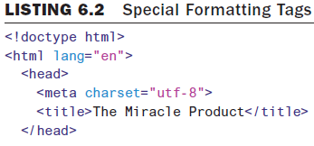
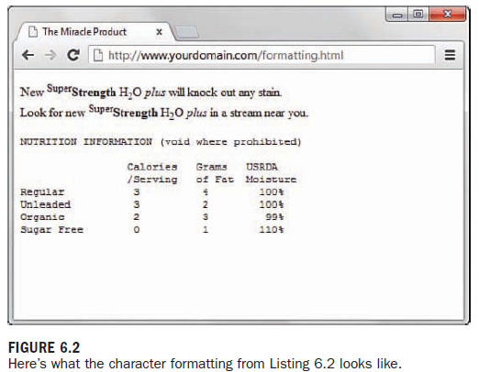
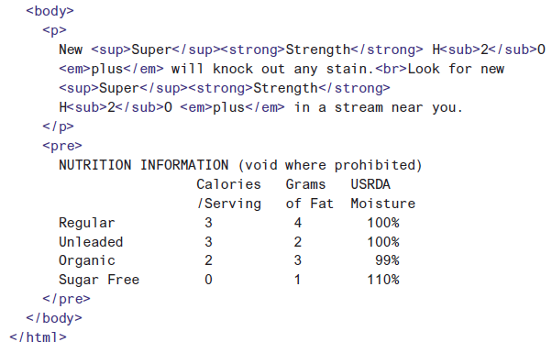
Working with Fonts, Text Blocks, Lists and Tables
Boldface, Italic, and Special Text Formatting:
There are a few HTML5 tags that are good for adding special formatting to text. Following are some of these tags:
  <sup></sup>—Superscript text
  <sub></sub>—Subscript text
  <em></em>—Emphasized (typically italic) text
  <strong></strong>—Strong (typically boldface) text
  <pre></pre>—Monospaced text, preserving spaces and line breaks
Listing 6.2 and Figure 6.2 demonstrate each of these tags in action.

Slide 22
Working with Fonts, Text Blocks, Lists and Tables
Fonts:
Before style sheets entered the picture, the now-phased-out <font> tag was used to control the fonts in web page text.
For example, the following HTML was once used to change the size and color of some text on a page:
<font size="5" color="purple">This text will be big and purple.</font>
As you can see, the size and color attributes of the <font> tag made it possible to alter the font of the text without too much effort. Although this approach worked fine, it was replaced with a far superior approach to font formatting, CSS style rules.
Following are a few of the main style rules used to control fonts:
font-family—Sets the family (typeface) of the font
font-size—Sets the size of the font
color—Sets the color of the font
<p style="font-family:arial, 'times roman', sans-serif; font-size:14pt; color:green;">

Slide 23
Working with Fonts, Text Blocks, Lists and Tables
Aligning Text on a Page
Using Style, Class, and ID Attributes
Attributes provide additional information related to an HTML tag. Attributes are special code words used inside an HTML tag to control exactly what the tag does.
Attributes invoke the use of styles, classes, or IDs that are applied to particular tags. In the following example, each paragraph could be left-aligned:
    <p style="text-align: left;">Text goes here.</p>
    <p class="leftAlignStyle">Text goes here.</p>
    <p id="firstLeftAlign">Text goes here.</p>
In the first paragraph, the style appears directly in the style attribute. This is useful for debugging or for short-term formatting tests.
In the second paragraph, the paragraph will be left-aligned if the style sheet entry for the .leftAlignStyle class includes the text-align statement; remember that using a class means other tags can reuse the class.
The third paragraph will be left-aligned if the style sheet entry for the #firstLeftAlign id includes the text-align statement; remember that using an id means these styles can be applied to only the one identified tag.

Slide 24
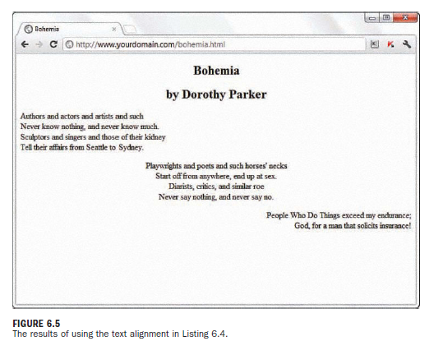
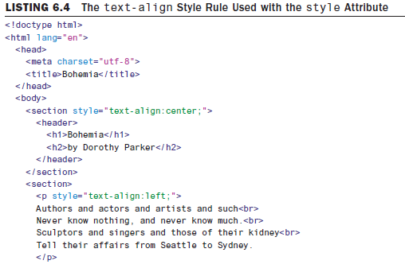
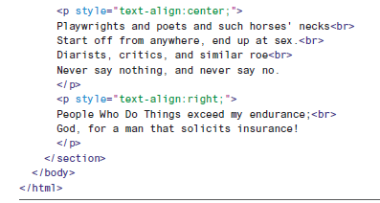
Working with Fonts, Text Blocks, Lists and Tables
Aligning Text on a Page (cont..)
2. Aligning Block-Level Elements
To align text in a block-level element such as <p> to the right margin without creating a separate class or ID in a style sheet, simply place style="text-align:right;" inside the <p> tag at the beginning of the paragraph (or define it in a class or an ID).
Similarly, to center the text in the element, use <p style="text-align:center;">. To align text in a paragraph to the left, use <p style="text-align:left;">.

Slide 25
Working with Fonts, Text Blocks, Lists and Tables
The Three Types of HTML Lists :
There are three basic types of HTML lists:
Ordered list—An indented list that has numbers or letters before each list item. The ordered list begins with the <ol> tag and ends with a closing </ol> tag. List items are enclosed in the <li></li> tag pair, and line breaks appear automatically at each opening <li> tag. The entire list is indented.
Unordered list—An indented list that has a bullet or another symbol before each list item. The unordered list begins with the <ul> tag and closes with </ul>. As with the ordered list, its list items are enclosed in the <li></li> tag pair. A line break and symbol appear at each opening <li> tag, and the entire list is indented.
Definition list—A list of terms and their meanings. This type of list, which has no special number, letter, or symbol before each item, begins with <dl> and ends with </dl>. The <dt></dt> tag pair encloses each term, and the <dd></dd> tag pair encloses each definition. Line breaks and indentations appear automatically.

Slide 26
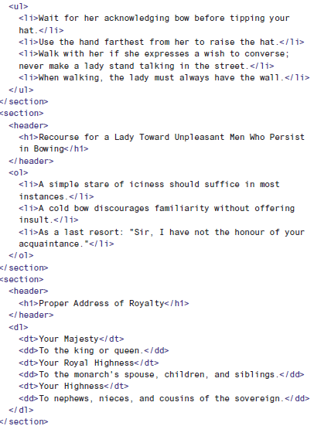
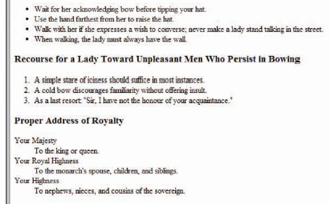
Working with Fonts, Text Blocks, Lists and Tables
The Three Types of HTML Lists (cont..):

Slide 27
Working with Fonts, Text Blocks, Lists and Tables
Creating a Simple Table:
Another method for controlling the layout of information within your web pages is to display that information within a table. A table consists of rows of information with individual cells inside.
To make a table, you have to start with a <table> tag and you end a table with the </table> tag.
The <tr> tag creates a table row, which contains one or more cells of information before the closing </tr>. To create these individual cells, use the <td> tag (<td> stands for table data). Place the table information between the <td> and </td> tags.
The <th> tag works exactly like a <td> tag, except that <th> indicates that the cell is part of the heading of the table.
You can add the following style sheet entries to add a basic border around the table and its cells (Figure 6.10):
            table, tr, th, td {
            border: 1px solid black;
            border-collapse: collapse;
            padding: 3px;
            }

Slide 28
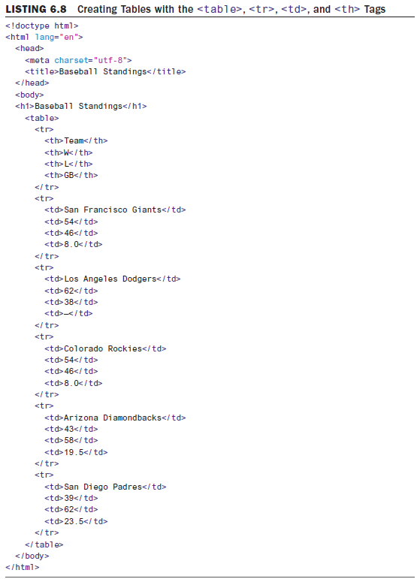
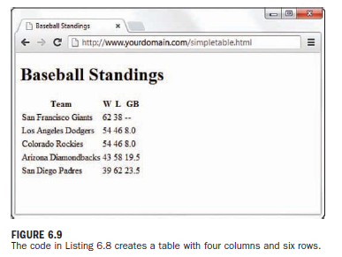
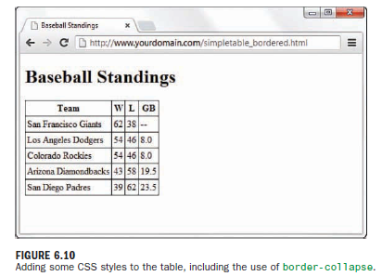
Working with Fonts, Text Blocks, Lists and Tables
Creating a Simple Table (cont..):

Slide 29
Working with Fonts, Text Blocks, Lists and Tables
Controlling Table Sizes:
To make the first cell of a table 20% of the total table width and the second cell 80% of the table width, you use the following property definitions:
      <table style="width:100%;">
      <tr>
      <td style="width:20%;">skinny cell</td>
      <td style="width:80%;">fat cell</td>
      </tr>
      </table>
<tr>
<th style="width: 200px;">Team</th>
<th style="width: 25px;">W</th>
<th style="width: 25px;">L</th>
<th style="width: 25px;">GB</th>
</tr>

Slide 30
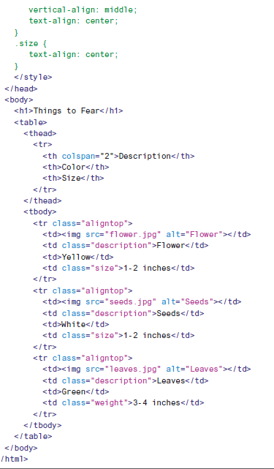
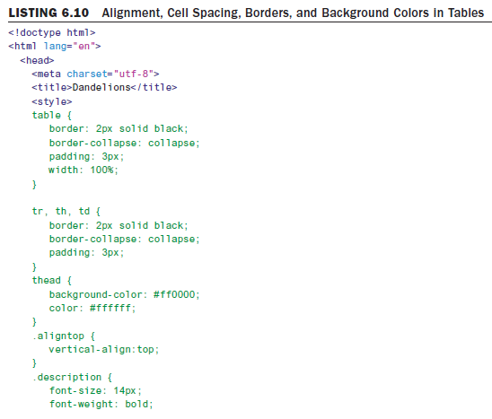
Working with Fonts, Text Blocks, Lists and Tables
Alignment and Spanning Within Tables:
You can align the contents of table cells both horizontally and vertically with the text-align and verticalalign style properties.
You can apply these alignment attributes to any <tr>, <td>, or <th> tag. Alignment attributes assigned to a <tr> tag apply to all cells in that row.

Slide 31
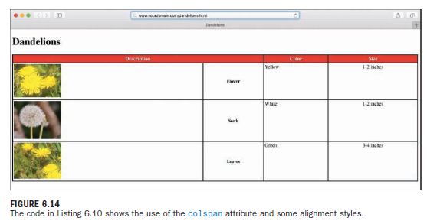
Working with Fonts, Text Blocks, Lists and Tables
Alignment and Spanning Within Tables (cont..):
Spanning is the process of forcing a cell to stretch across more than one row or column of a table. The colspan attribute causes a cell to span multiple columns; rowspan has the same effect on rows.
At the top of Figure 6.14, a single cell (Description) spans two columns. This is accomplished with the colspan attribute in the <th> tag for that cell. As you might guess, you can also use the rowspan attribute to create a cell that spans more than one row.

Slide 32
Using External and Internal Links
Using Web addresses:
An attribute is a piece of information associated with a tag that provides further details about the tag. For example, the href attribute of the <a> (anchor) tag identifies the address of the page or document to which you are linking.
Suppose you are creating a page named zoo.html in your document root, and you want to include a link to pages named african.html and asian.html in the elephants subdirectory.
The links would look like the following:
    <a href="/elephants/african.html">Learn about African elephants.</a>
    <a href="/elephants/asian.html">Learn about Asian elephants.</a>
Your african.html and asian.html documents in the elephants subdirectory could link back to the main zoo.html page in either of these ways:
    <a href="http://www.yourdomain.com/zoo.html">Return to the zoo.</a>
    <a href="/zoo.html">Return to the zoo.</a>
    <a href="../zoo.html">Return to the zoo.</a>

Slide 33
Using External and Internal Links
Using Web addresses (cont..):
The first link is an absolute link. With an absolute link, there is absolutely no doubt where the link should go because the full URL is provided—domain name included.
The second link is a relative-root link. It is relative to the domain you are currently browsing and, therefore, does not require the protocol type (for example, http://) or domain name (for example, www.yourdomain.com); the initial forward slash is provided to show that the address begins at the document root.
In the third link, the double dot (..) is a special command that indicates the folder that contains the current folder—in other words, the parent folder. Anytime you see the double dot, just think to yourself, “Go up a level in the directory structure.”
The advantage of relative addressing is that the links will work as long as the pages remain on the same site. If you use relative addressing consistently throughout your web pages, you can move directories of pages to another folder, disk drive, or web server without changingthe links.

Slide 34
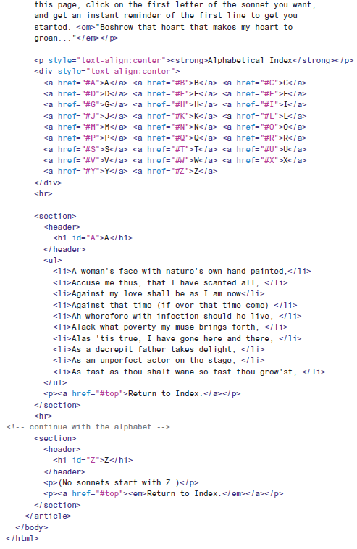
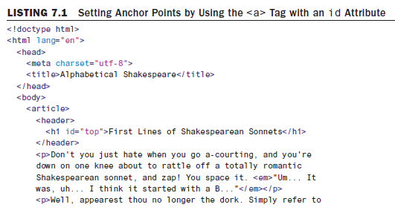
Using External and Internal Links
Linking Within a Page Using Anchors:

Slide 35
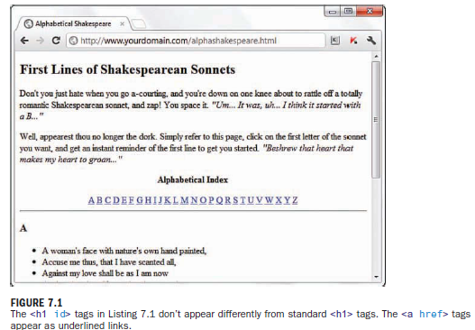
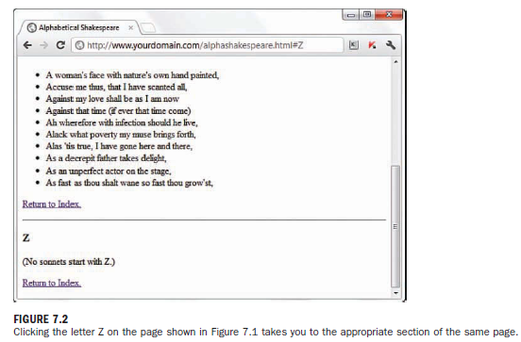
Using External and Internal Links
Linking Within a Page Using Anchors (cont..):

Slide 36
Using External and Internal Links
Linking to Non-HTML Files:
Once you know how to link to an HTML document, you can link to non-HTML documents in the same way. Items like word processing documents and PDF files are examples of other files on the web.
To link to them, you just replace the URL in the href attribute with the location of the
document, as in these examples:
    <a href="myWordDoc.doc">my word-processed document</a>
    <a href="myPDFfile.pdf">my PDF file</a>
The first example links to a word processing document (.doc), and the second example links to a PDF file (.pdf). When these links are clicked, the browser will do one of two things: It will either open the document in the window or it will open a download dialog box that asks the user to download the file.
Linking to External Web Content:
The only difference between linking to pages within your own site and linking to external web content is that when linking outside your site, you need to include the full address to that bit of content.
For example, to include a link to Google from within one of your own web pages, you would use this type of absolute addressing in your <a> link:
<a href="https://www.google.com/">Go to Google</a>

Slide 37
Using External and Internal Links
Linking to an Email Address:
An HTML link to an email address looks like the following:
<a href="mailto:yourusername@yourdomain.com">Send me an email message.</a>
The words Send me an email message will appear just like any other <a> link.
You can add carbon-copy and blind carbon-copy recipients to the message as well with the cc and bcc properties, like so:
<a href="mailto:author@somedomain.com?subject= Book Question&cc=coauthor@somedomain.com& bcc=publisher@somedomain.com">Mail the author</a>
Opening a Link in a New Browser Window:
A valid HTML link that opens in a new window is constructed like so:
<a href="/some/file.html" target="_blank">Open a Window!</a>
The keyword _blank is a special target name that tells the browser to open in a new window without a name. The initial underscore (_) is not a typo but is part of the name. You can also give windows names by targeting them with any text designation, such as the following:
<a href="/some/file.html" target="newWindow">Open a New Window!</a>

Slide 38
Using External and Internal Links
Giving Titles to Links:
One feature of links that many web designers forget is the title attribute. This attribute lets you add to your links descriptions that aren’t immediately visible on web pages. For example, this HTML creates a link that reads Come see my page:
<a href="myPage.html" title="This is the best page on this site"> Come see my page</a>
When people view the page, it will display as a standard link, but if they hover over or focus on the link, the browser will display the message This is the best page on this site.
Using CSS to Style Hyperlinks:
These are the common pseudo-classes for the <a> tag:
a:link—Describes the style of a hyperlink that has not been visited previously.
a:visited—Describes the style of a hyperlink that has been visited previously and is present in the browser’s memory.
a:hover—Describes the style of a hyperlink as a user’s mouse hovers over it (and before it has been clicked).
a:focus—Describes the style of a hyperlink as the user activates the link. This is often used on devices where there is no mouse, so clicking is not possible.
a:active—Describes the style of a hyperlink that is in the act of being clicked but has not yet been released.

Slide 39
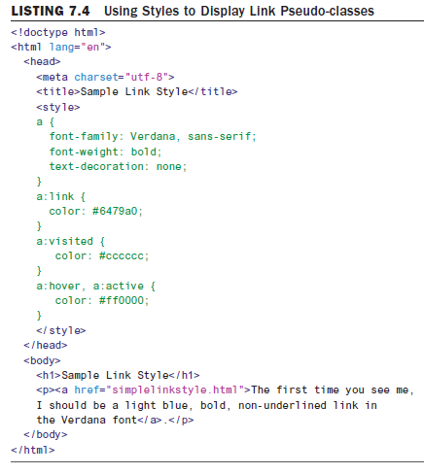
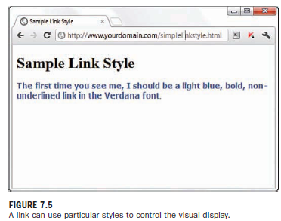
Using External and Internal Links
Using CSS to Style Hyperlinks (cont..):

Slide 40
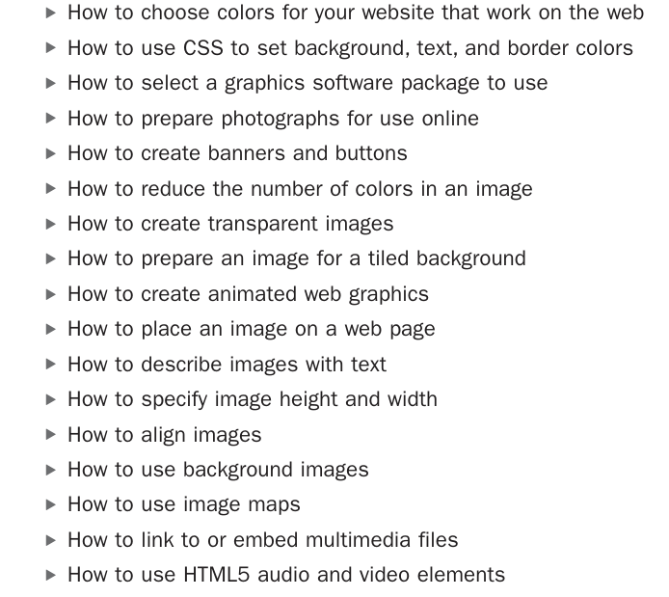
Working with Colors, Images, and Multimedia

Slide 41
Working with Colors, Images, and Multimedia
Best Practices for Choosing Colors:
  Use a natural palette of colors
  Use accessible color combinations
  Use colors with good contrast, especially for blocks of text
  Use a small color palette
  Consider your demographics
Some common color schemes in web design are given here:
Analogous—Using colors that are adjacent to each other on the color wheel, such as yellow and green. One color is the dominant color, and its analogous friend enriches the display.
Complementary—Using colors that are opposite each other on the color wheel, such as a warm color (red) and a cool color (green).
Monochromatic—Using colors that are all the same primary hue. The secondary colors are created by adding white and black to the primary color.
Triadic—Using three colors that are equally spaced around the color wheel. The triadic scheme provides balance while still allowing rich color use.

Slide 42
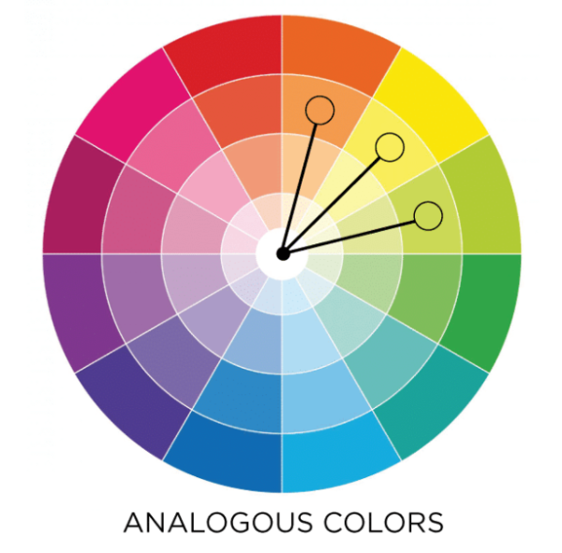
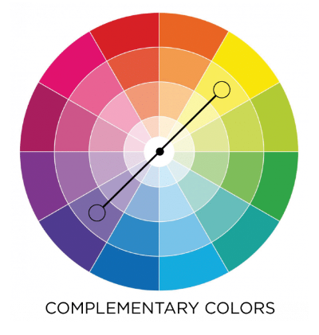
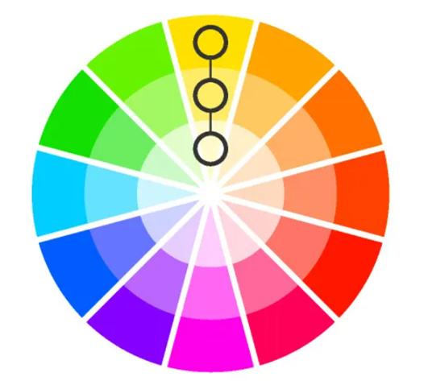


Working with Colors, Images, and Multimedia
DEMO: https://www.w3schools.com/colors/colors_monochromatic.asp

Slide 43

Working with Colors, Images, and Multimedia
Using Hexadecimal Values for Colors:
The hexadecimal color format is #rrggbb, in which rr, gg, and bb are two-digit hexadecimal values for the red (rr), green (gg), and blue (bb) components of the color. Just remember that ff is the maximum, and 00 is the minimum.
Use one of the following codes for each component:
  ff means full brightness.
  cc means 80% brightness.
  99 means 60% brightness.
  66 means 40% brightness.
  33 means 20% brightness.
00 means none of this color component.
For example, bright red is #ff0000, dark green is #003300, bluish-purple is #660099, and medium gray is #999999. To make a page with a red background and dark green text, you could use the following HTML code within inline styles:
<body style="background-color:#ff0000; color:#003300;">

Slide 44

Working with Colors, Images, and Multimedia
Using RGB and RGBa Values for Colors:
Hexadecimal codes define the red, green, and blue percentages of each color for millions of colors. But you can also define those colors with RGB values.
The RGB format is rgb (red, green, blue), where red, green, and blue are values of 0 to 255—just like hexadecimal, but written in base-10 numbers (decimal) rather than base-16 (hexadecimal).
You simply need to remember that 255 is the maximum, and 0 is the minimum.
Use the following values in your RGB colors:
  255 means full brightness.
  204 means 80% brightness.
  153 means 60% brightness.
  102 means 40% brightness.
  51 means 20% brightness.
  0 means none of this color component.
To make a page with a red background and dark green text using RGB, you could use the following CSS:
background-color:rgb(255,0,0); color:rgb(0,51,0);

Slide 45
Working with Colors, Images, and Multimedia
Using RGB and RGBa Values for Colors (cont..):
To define the alpha transparency, you write your RGB color with one extra value: rgba(red, green, blue, transparency).
The transparency value is a number between 0 and 1, representing the transparency percentage. 0 is fully transparent, meaning the background is all you see, 1 is fully opaque meaning the background is completely covered, and 0.5 is 50% transparent.
To make a page with faded cornflowerblue text on a white background, you could use this CSS:
body { color: rgba(100,149,237,0.5); }
Using CSS to Set Background, Text, and Border Colors:
            #paragraph {
            background-color: #cccccc;
            color: #ff0000;
            border:1px solid #000000;
            }

Slide 46


Working with Colors, Images, and Multimedia
Placing Images on a Web Page:
Let’s assume you have placed an image called myimage.gif in the same directory as the HTML file you want to use to display it. To display it, insert the following HTML tag at the point in the text where you want the image to appear, using the name of your image file instead of myimage.gif:
<img src="myimage.gif" alt="My Image">

Slide 47

Working with Colors, Images, and Multimedia
Specifying Image Height and Width:
For each image you want to include in your site, you can use your graphics program to determine its exact height and width in pixels.
When you know the height and width of an image, you can include its dimensions in the CSS, like this:
<img src="myimage.gif" alt="Fancy Pic" style="width:200px;height:100px;">
Aligning Images:
Horizontal Image Alignment:
  <img style="float:left;"> aligns the first image to the left and wraps text around the right side of it.
  Similarly, <img style="float:right;"> aligns the second image to the right and wraps text around the left side of it.

Slide 48


Working with Colors, Images, and Multimedia
Vertical Image Alignment:
To line up the top of an image with the top of the tallest image or letter on the same line, use this: <img style="vertical-align:text-top;">
To line up the bottom of an image with the bottom of the text, use this: <img style="vertical-align:text-bottom;">
To line up the middle of an image with the overall vertical center of everything on the line, use this: <img style="vertical-align:middle;">
To line up the bottom of an image with the baseline of the text, use this:<img style="vertical-align:baseline;">

Slide 49
Working with Colors, Images, and Multimedia
Turning Images into Links:
To turn any image into a clickable link to another page or image, you can use the <a> tag.
      <a href="http://www.flickr.com/photos/nofancyname/614253439/">
      <img src="elcap_sm.jpg" alt="El Capitan"
      style="width:100px; height:75px;">
      </a>
Using Background Images:
The basic CSS properties that work together to create a background are listed here:
background-color—Specifies the background color of the element.
background-image—Specifies the image to use as the background of the element, using the following syntax: url('imagename.gif’).
background-repeat—Specifies how the image should repeat, both horizontally and vertically. Options are repeat (same as default), repeat-x (horizontal), repeat-y (vertical), and no-repeat (only one appearance of the graphic).
background-position—Specifies where the image should be initially placed, relative to its container. Options include top-left, top-center, top-right, center-left, center-center, center-right, bottom-left, bottom-center and bottom-right.

Slide 50


Working with Colors, Images, and Multimedia
Linking to Multimedia Files:
You could use the following line to offer an MOV video of a cute chickadee:<a href="chickadee.mov">View a cute chickadee!</a>
When the user clicks the words View a cute chickadee!, the chickadee.mov QuickTime video file is transferred to his or her computer from your web server.
Whichever helper application or plug-in the user has installed automatically starts as soon as the file has finished downloading.
If no compatible helper or plug-in can be found, the web browser offers the user a chance to download the appropriate plug-in or save the video on the hard drive for later viewing.

Slide 51
Working with Colors, Images, and Multimedia
Embedding Multimedia Files:
HTML5 introduced two new tags for embedding media files in a web page: <video> and <audio>.
      <video controls style="width: 400px; height: auto;"
      src="chickadee.wmv" type="video/x-ms-wmv">
      <p>Your browser does not support HTML5 video.</p>
      </video>
The <video> element contains the fallback text Your browser does not support HTML5 video. that is displayed only if the tag doesn’t display—much like the alt attribute in the <img> tag.
    <audio
    src="manhattan_beach.mp3"
    preload="auto"
    controls
    autoplay
    loop>
    <p>Your browser does not support
    the audio element.</p>
    </audio>
preload—Has three possible values: none, auto, and metadata. Use none if you do not want to buffer the file, use auto to buffer the file, and use metadata if you want to buffer only the metadata for the file.
controls—If present, shows the controls for the audio player.
autoplay—If present, plays the file as soon as it loads.
loop—If present, continues to play the file repeatedly until it is manually stopped

Slide 52
Understanding Cascading Style Sheets (CSS)

Slide 53
STYLE SHEETS
Basics of HTML Learned Previously:
Setting up a basic HTML template for web content.
Introduction to CSS:
CSS (Cascading Style Sheets) fine-tunes the display of web content.
Concept of Style Sheets:
  A style sheet document specifies fonts, colors, spacing, and other characteristics.
  Linked to every page to ensure consistent styling across the website.
  Changing styles in the style sheet updates all linked pages simultaneously.
Advantages of Using Style Sheets:
  Grouping formatting instructions for multiple HTML pages.
  Setting various formatting characteristics like typeface controls, letter and line spacing, margins, and page borders.
  Specifying sizes and measurements in familiar units (inches, millimeters, points, picas).
  Precisely positioning graphics and text on a web page (specific coordinates or relative to other items

Slide 54
CSS Evolution
CSS1: Introduced in 1996.
CSS2: Introduced in 1998, still in use today.
CSS3: Builds on CSS1 and CSS2, adding advanced functionality.
The latest version of CSS is CSS3, and it builds on the strong foundation laid by its predecessors but adds advanced functionality to enhance the online experience. Modern web browsers support all of CSS2 and a majority of CSS3.

Slide 55
How CSS Works
CSS Overview:
CSS (Cascading Style Sheets) is a language for defining styles like fonts, colors, and positioning.
Storage of CSS:
  Styles can be embedded directly in an HTML page (Internal) or stored in a separate .css file (external).
  External style sheets link to HTML pages via a special tag <link>.
Style Rules:
  A style rule is a formatting instruction for web page elements (e.g., paragraphs, links).
  Consists of style properties and their values.
Internal vs. External Style Sheets:
  Internal style sheets are within an HTML document.
  External style sheets are separate documents linked to HTML pages.
Cascading Mechanism:
- Style rules form a hierarchy where specific styles override general styles.

Slide 56


STYLE PROPERTIES
Basic Layout Properties – 1) DISPLAY PROPERTY
Describes how an element is displayed with respect to other elements.
Five basic values:

Slide 57

STYLE PROPERTIES -
display : block;
<!DOCTYPE html>
<html>
<head>
<style>
span {
display: block;
}
</style>
</head>
<body>
<h1>Display span elements as block elements</h1>
<span>A display property with</span> <span>a value of "block" results in</span>
<span>a line break between each span elements.</span>
</body>
</html>
OUTPUT:

Slide 58




STYLE PROPERTIES -
display : list - item

Slide 59
STYLE PROPERTIES -
others
Other elements can be viewed here.
https://www.w3schools.com/cssref/pr_class_display.php

Slide 60

STYLE PROPERTIES (contd…)
Basic Formatting Properties : width and height property
Describes how to control the dimensions of the rectangular area for an element.
DEMO:
https://www.w3schools.com/cssref/tryit.php?filename=trycss_dim_width

Slide 61

Basic Formatting Properties
Basic Formatting Properties – Border property
Establishes a visible boundary around an element with a box or partial box

Slide 62
Basic Formatting Properties
Basic Formatting Properties : border - width property
The border-width property sets the width of an element's four borders. This property can have from one to four values.
Examples:
border-width: thin medium thick 10px;
  top border is thin
  right border is medium
  bottom border is thick
  left border is 10px
border-width: thin medium thick;
  top border is thin
  right and left borders are medium
  bottom border is thick
border-width: thin medium;
  top and bottom borders are thin
  right and left borders are medium
border-width: thin;
  all four borders are thin
DEMO:
https://www.w3schools.com/cssref/playdemo.php?filename=playcss_border-width

Slide 63

Basic Formatting Properties
Basic Formatting Properties : border - color property
p.one {
border-style: solid;
border-color: red;
}
p.two {
border-style: solid;
border-color: green;
}
p.three {
border-style: dotted;
border-color: blue;
}
DEMO:
https://www.w3schools.com/css/tryit.asp?filename=trycss_border-color1

Slide 64


Basic Formatting Properties
Text : color, background –color
The color of the inner region of an element is set using the color and background-color properties.
color : Sets the color of text in an element (foreground)
background-color : Sets the color of the background behind the text.
Assign custom colors to these properties by specifying the colors in hexadecimal or as
RGB (red, green, blue) decimal values:
DEMO:
Text color
https://developer.mozilla.org/en-US/docs/Web/CSS/color
Background color
https://developer.mozilla.org/en-US/docs/Web/CSS/background-color

Slide 65

Basic Formatting Properties
Text : Alignment and Indentation property
The text can be aligned in four ways. START, END, CENTER & JUSTIFY.
DEMO:
Text Alignment
https://developer.mozilla.org/en-US/docs/Web/CSS/text-align
The text-indent property in CSS : Used to define the indentation of the first line in each block of text. It also take negative values. It means if the value is negative then the first line will be indented to the left.
DEMO:
Text Identation
https://developer.mozilla.org/en-US/docs/Web/CSS/text-indent

Slide 66

Basic Formatting Properties
Basic Formatting Properties : border - style property
DEMO:
https://www.w3schools.com/css/tryit.asp?filename=trycss_border-style

Slide 67

Basic Formatting Properties
Basic Formatting Properties : left, right, top, bottom property
In CSS, there are also properties for specifying each of the borders (top, right, bottom, and left):
DEMO:
https://www.w3schools.com/css/tryit.asp?filename=trycss_border-side

Slide 68


Basic Formatting Properties
Basic Formatting Properties : border - radius property
Following is an example of using the border property to set a border that consists of
two (double) red lines that are a total of 10 pixels in width:
To adjust the curve of the boxes by changing the border radius. Rounds the corners of
both the border and any background placed on the element.
DEMO:
https://developer.mozilla.org/en-US/docs/Web/CSS/border-radius

Slide 69


Using Style Classes
A style class is a custom set of formatting specifications that can be
applied to any element in a web page.
SELECTOR:
We can associate a style property and its respective value with elements on a web
page by using a selector.
A selector is used to identify tags on a page to which you apply styles.
Eg:
In this code, h1 is the selector, font is the style property, and 36pt Courier is the value. The selector is important because it means that the font setting will be applied to all h1 elements in the web page.
DEMO: https://www.w3schools.com/cssref/tryit.php?filename=trycss_sel_class_more

Slide 70

Using Style Classes
A style class is a custom set of formatting specifications that can be
applied to any element in a web page.
if you want to differentiate between some of the <h1> or <p>elements? The answer lies in style classes.
Suppose you want two different kinds of <p> elements for use in your documents.
You create a style class for each one by putting the following CSS code in a style sheet:
p.center { text-align: center; color: red; }
p.large { font-size: 300%; }
This <p> element will be styled according to class="center" AND to class="large":
DEMO:
https://www.w3schools.com/cssref/tryit.php?filename=trycss_sel_class_more2
NOTE: What makes style classes so valuable is that they isolate style code from web pages, enabling you to focus your HTML code on the actual content in a page rather than on how it is going to appear on the screen.

Slide 71
Using Style IDs
A style ID is a custom set of formatting specifications that can be applied to only one element in a web page.
When we want precise control over unique elements for layout or formatting purposes (or both). In such instances, look to IDs instead of classes.
NOTE: You can use IDs across a set of pages—but only once within each page.
For example, suppose you have a title within the body of all your pages. Each page has only one title, but each page includes one instance of that title. Following is an example of a selector with an ID indicated, plus a property and a value:
p#title {font: 24pt Verdana, Geneva, Arial, sans-serif}
Notice that this selector includes a hash tag, or pound sign (#), after p, followed by a descriptive ID name. When referencing a style ID in HTML code, simply specify the ID name in the id attribute of an element, like so:
<p id="title">Some Title Goes Here</p>
Everything between the opening and closing <p> tags will appear in 24-point Verdana text—but only once on any given page. You often see style IDs used to define specific parts of a page for layout purposes, such as a header area, footer area, main body area, and so on. These types of areas in a page appear only once per page, so using an ID rather than a class is the appropriate choice.

Slide 72



Using Style IDs
A style ID is a custom set of formatting specifications that can be applied to only one element in a web page.
The #id selector styles the element with the specified id.
DEMO: https://www.w3schools.com/cssref/tryit.php?filename=trycss_sel_id
OUTPUT:

Slide 73
Internal style sheets and Inline styles
Three Ways to insert CSS
External CSS
Internal CSS
Inline CSS
External CSS:
Change the look of an entire website by changing just one file.
Each HTML page must include a reference to the external style sheet file inside the <link> element, inside the head section.
External styles are defined within the <link> element, inside the <head> section of an HTML page

Slide 74



External style Sheet - Example
OUTPUT:

Slide 75


A Basic Style Sheet (Contd…)
Internal CSS
2) Internal CSS
An internal style sheet may be used if one single HTML page has a unique style.
The internal style is defined inside the <style> element, inside the head section.
OUTPUT

Slide 76
A Basic Style Sheet (Contd…)
2) Internal CSS
An internal style sheet may be used if one single HTML page has a unique style.
The internal style is defined inside the <style> element, inside the head section.
OUTPUT

Slide 77


A Basic Style Sheet (Contd…)
Inline CSS
2) Inline CSS
An inline style may be used to apply a unique style for a single element.
To use inline styles, add the style attribute to the relevant element. The style attribute can contain any CSS property.
OUTPUT:

Slide 78

How CSS Works
Parent <div> Style:
The <div> element has an inline style color: green;, making its text green by default.
First <p> Element:
The first <p> element inside the <div> has an inline style color: blue;, which overrides the parent's green color, making its text blue.
Second <p> Element:
The second <p> element does not have its own inline style for color, so it inherits the green color from the parent <div>.

Slide 79

How CSS Works (Contd..)
OUTPUT

Slide 80

SUMMARY OF TAGS LEARNT

Slide 81
Working with Margins, Padding, Alignment, and Floating

Slide 82
Using Margins
margin and padding—For adding space around elements
align and float—For placing your elements in relationship to others
Style sheet margins enable you to add empty space around the outside of the rectangular area for an element on a web page. It is important to remember that the margin property works with space outside the element.
Following are the style properties for setting margins:
  margin-top—Sets the top margin
  margin-right—Sets the right margin
  margin-bottom—Sets the bottom margin
  margin-left—Sets the left margin
  margin—Sets the top, right, bottom, and left margins as a single property
If you want the margin around each <div> to be 15 pixels on all sides, you can use the following:
margin-top: 15px;
margin-right: 15px;
margin-bottom: 15px;
margin-left: 15px;
(OR) margin: 15px 15px 15px 15px;
(OR) margin: 15px;

Slide 83



Using Margins

Slide 84


Using Margins
To produce the following:
  No margin around the first color block
  A left-side margin of 15 pixels, a top margin of 5 pixels, and no bottom margin around the second color block
  A left-side margin of 75 pixels and no top margin or bottom margin around the third color block
  A left-side margin of 250 pixels and a top margin of 25 pixels around the fourth color block

Slide 85


Padding elements
Adding padding is similar to using margins, in that both add extra space to elements. The big difference is where that space is located. Recall that margins are added to the outsides of elements.
On the other hand, padding adds space inside the rectangular area of an element.
The following properties are available for use in setting the padding of style rules:
padding-top—Sets the top padding
padding-right—Sets the right padding
padding-bottom—Sets the bottom padding
padding-left—Sets the left padding
padding—Sets the top, right, bottom, and
left padding as a single property

Slide 86
Keeping Everything Aligned
Because content on a web page doesn’t always fill the entire width of the rectangular area in which it is displayed, it is often helpful to control the alignment of the content.
Two style properties enable you to control the alignment of elements inside a box: text-align and vertical-align.
As a refresher, using text-align aligns an element horizontally within its bounding area, and it can be set to left, right, center, or justify.
The vertical-align property is similar to text-align except that it is used to align elements vertically.
A good example is a row of images that appear one after the next; the vertical-align property enables you to align them vertically.
Following are common values for use with the vertical-align property:
  top—Aligns the top of an element with the current line
  middle—Aligns the middle of an element with the middle of its parent
  bottom—Aligns the bottom of an element with the current line
  text-top—Aligns the top of an element with the top of its parent
  baseline—Aligns the baseline of an element with the baseline of its parent
  text-bottom—Aligns the bottom of an element with the bottom of its parent

Slide 87
Centering Blocks of Content
While you can center text and other inline elements (such as links or buttons) with text-align: center; getting things like images or text boxes to center is difficult.
If you’re trying to center an image or a block of content in your design, the easiest way is to change the horizontal (left and right) margins to auto, like so:
  margin-left: auto;
  margin-right: auto;
You can also use the margin shorthand property:
  margin: 0 auto;

Slide 88



Understanding the float Property
The float property allows elements to be moved around in the design so that other elements can wrap around them. You often find float used in conjunction with images but you can float all sorts of elements in the layout.
Elements float horizontally, not vertically, with two possible values: right and left.
Problem: These three color blocks were supposed to be floated next to each other, but the browser window is not wide enough to display these three 250-pixel-wide blocks with 25 pixels of margin between them. Because they are floating, the third one simply floats to the next line.
Solution: making the color blocks only 100 pixels wide, reducing the margins to 10px, and changing the float alignment of the second color block to right (instead of left).

